Slide 1
Aviation Marketing Project
Presented by: Omar Ossama

Slide 2
Aim of Study
Understand consumer needs
Predict consumer satisfaction

Slide 3
Data report
Dataset contain 24 unique variables
Dataset had a total of 41,791 missing values
All numerical variables (except Age) had outliers

Slide 4
Methods used
EDA
Predictive Modeling

Slide 5
Insights from the EDA

Slide 6
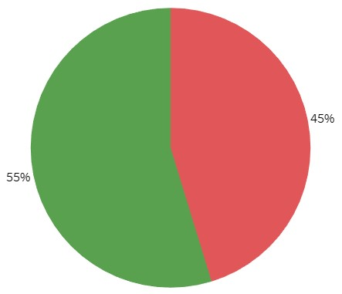
Insights from EDA
Falcon airlines has a 55% satisfaction rate

Slide 7
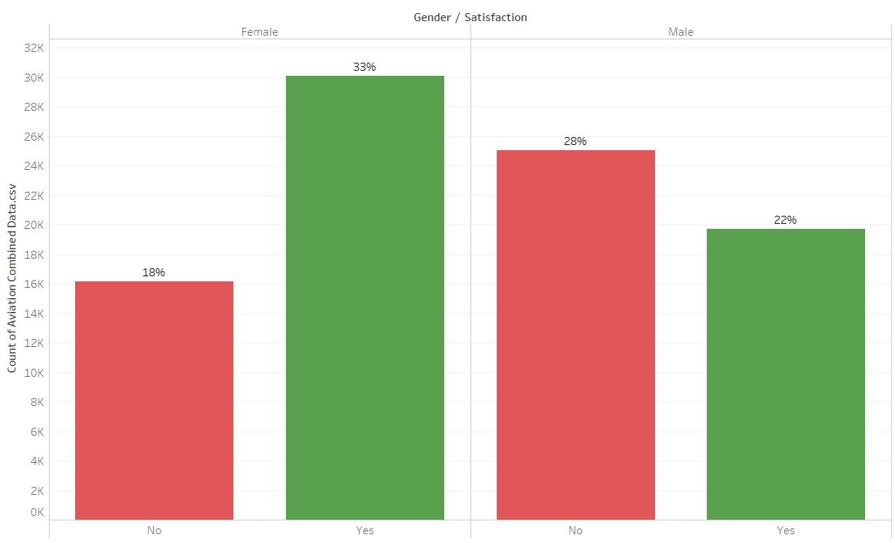
Insights from EDA
Males were more likely to not be satisfied by the services provided by the airlines

Slide 8
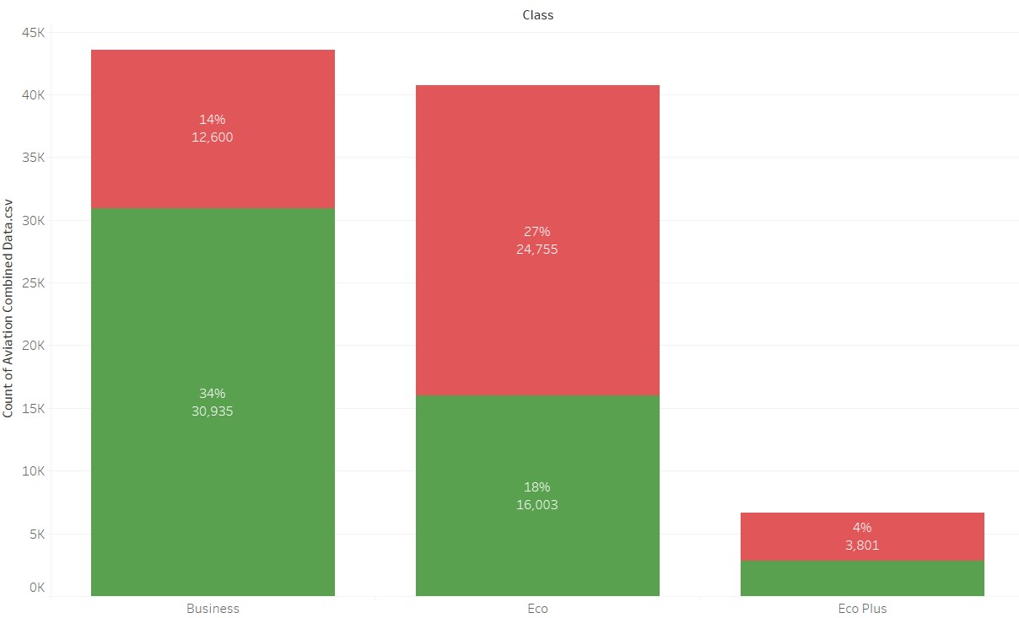
Insights from EDA
Eco Plus class was significantly less used
Eco Plus and Eco classes had a relatively low satisfaction rate (43% and 39% respectively)

Slide 9
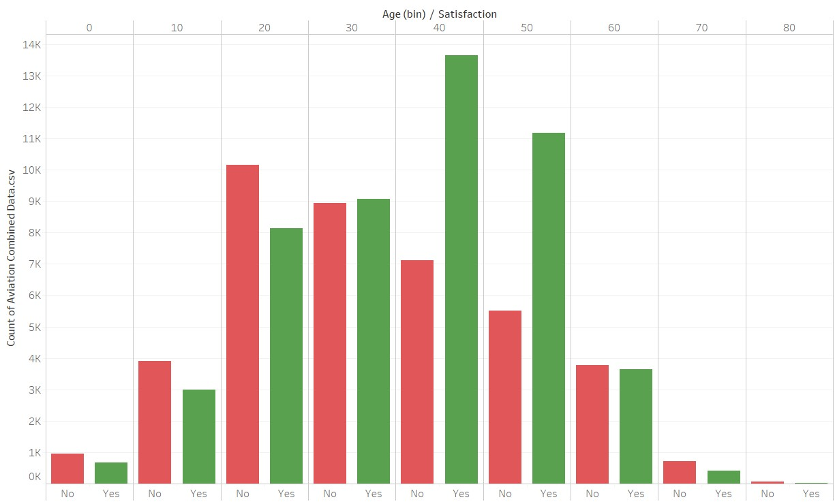
Insights from EDA
40-60 years old are the only age group that are more likely to be satisfied than not

Slide 10
Insights From Predictive Models

Slide 11
Insights from Predictive Models
Inflight entertainment, Seat comfort and Online services were the most impactful variables
Males are more likely to be neutral or not satisfied
Customers that do not fly Business Class are more likely to be neutral or not satisfied
Loyal customers usually do not give bad reviews on their trips

Slide 12
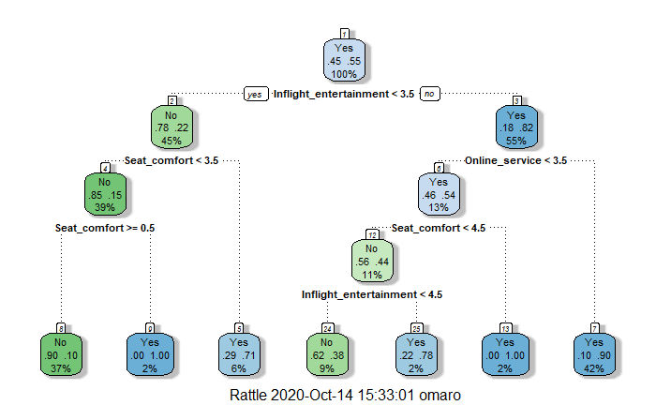
CART Model

Slide 13
Model Metrics

Slide 14
CART Model Metrics
Train data
Test data
Accuracy = 87%
Sensitivity = 86%
Specificity = 87%
Accuracy = 87%
Sensitivity = 87%
Specificity = 87%

Slide 15
Logistic Regression Model Metrics
Train data
Test data
Accuracy = 84%
Sensitivity = 82%
Specificity = 85%
Accuracy = 83%
Sensitivity = 82%
Specificity = 85%

Slide 16
XGB Model Metrics
Train data
Test data
Accuracy = 88%
Sensitivity = 87%
Specificity = 89%
Accuracy = 88%
Sensitivity = 88%
Specificity = 88%

Slide 17
Random Forest Model Metrics
Train data
Test data
Accuracy = 100%
Sensitivity = 100%
Specificity = 100%
Accuracy = 95%
Sensitivity = 95%
Specificity = 94%

Slide 18
Recommendations

Slide 19
Recommendations
The company should focus more the groups that were found to be more likely to not be satisfied by the airline. These groups include:
Males
Customers under 40 and over 60
Non-Business Class users

Slide 20
Recommendations
Maintaining and improving the Inflight and Online services should be an important and achievable goal for the company as it will translate to more satisfied customers and more profits for the company

Slide 21
Recommendations
While seat comfort is not a realistic variable to control. It should be taken into consideration if the company ever decides to buy a new airliner or upgrade an existing one

Slide 22
Thank you for your attention!
Questions?

